Slide 1

Jordan university of science and technology computer science department high performance computing course
Dr. yaser Jararwah
By:
Hanan hamasha-156836

Slide 2
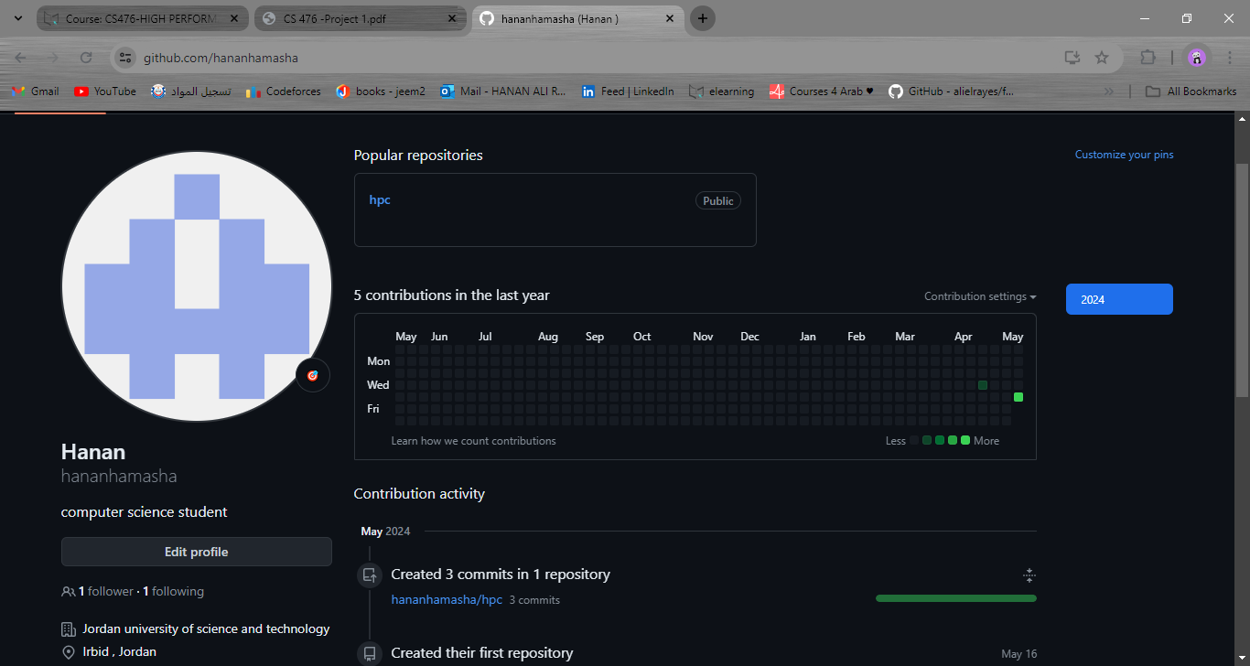
My github handle is : hananhamasha

Slide 3
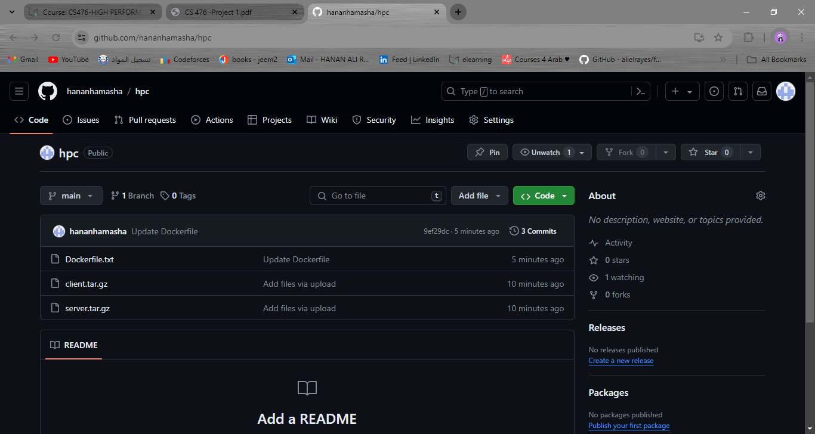

Slide 4
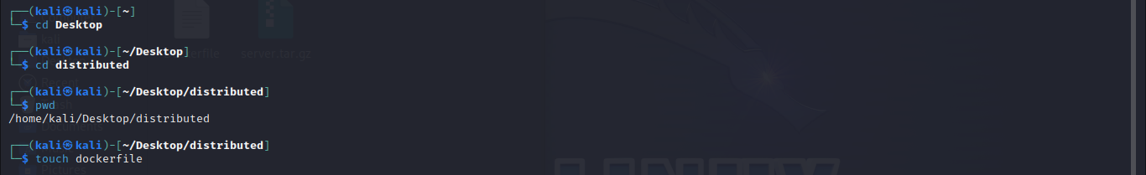
I used kali linux to solve the assignment: access to folder distributed and create the dockerfile

Slide 5
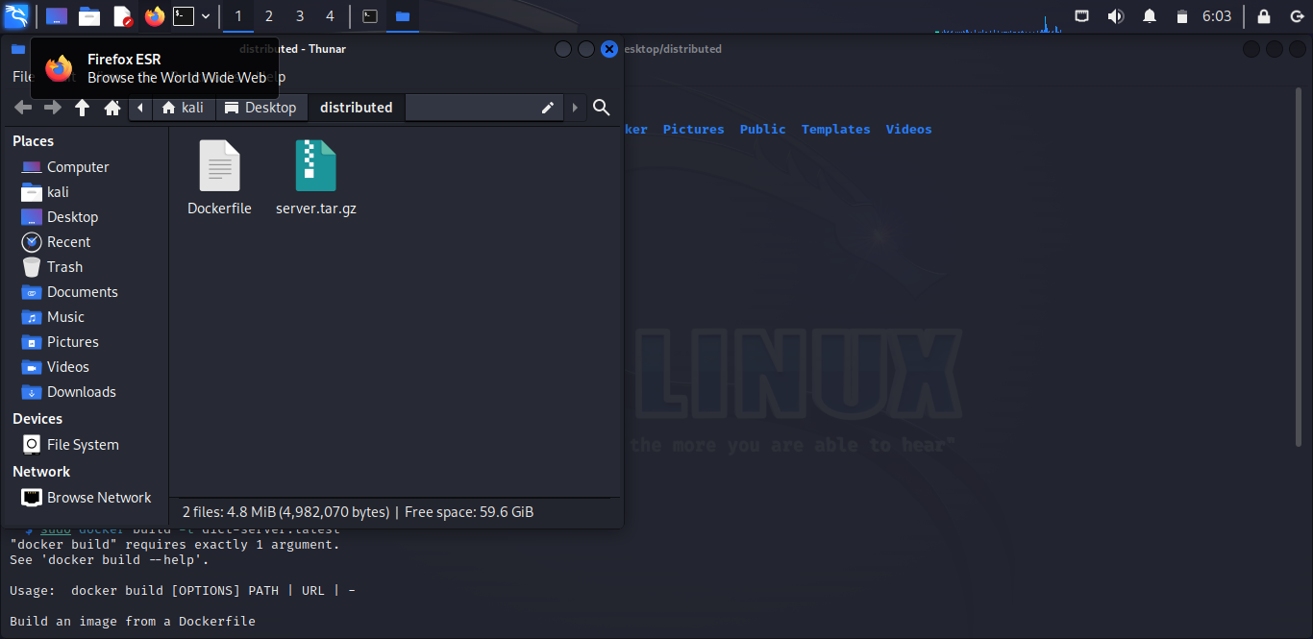
In the home of kali linux I created the distributed file and then put the server file inside :

Slide 6
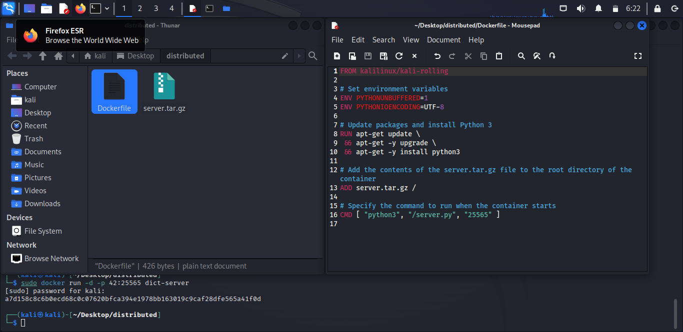
I filled the dockerfile :

Slide 7
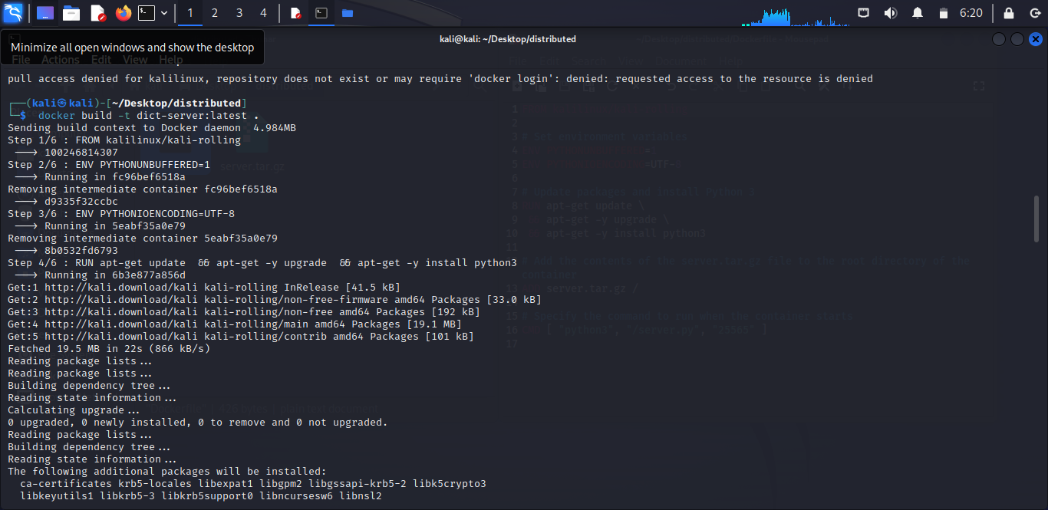
Build an image:

Slide 8
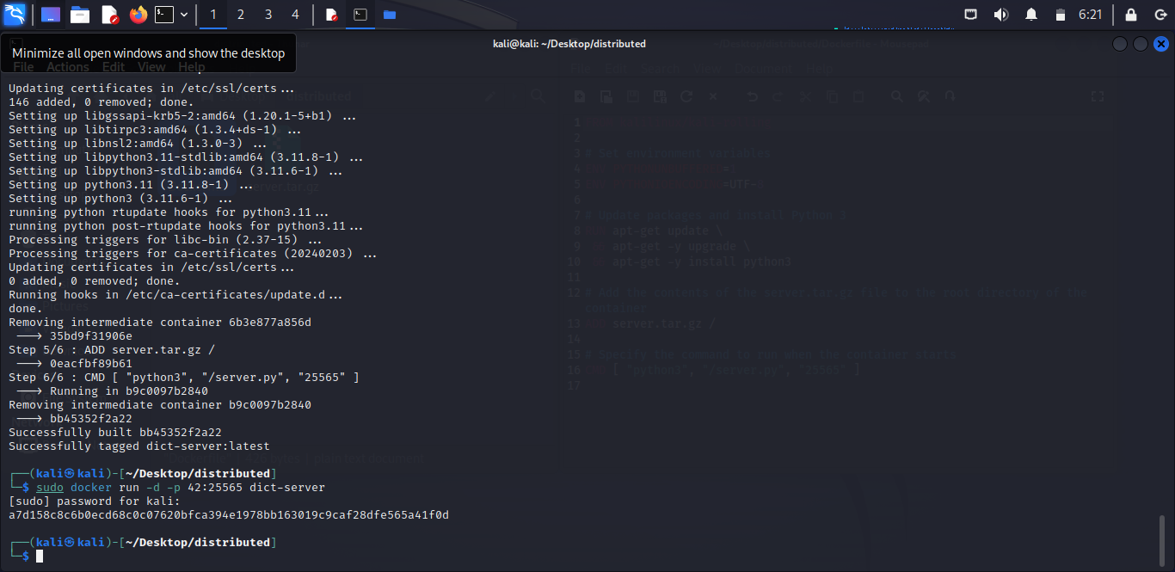
Run the image (deploying a Docker container):

Slide 9
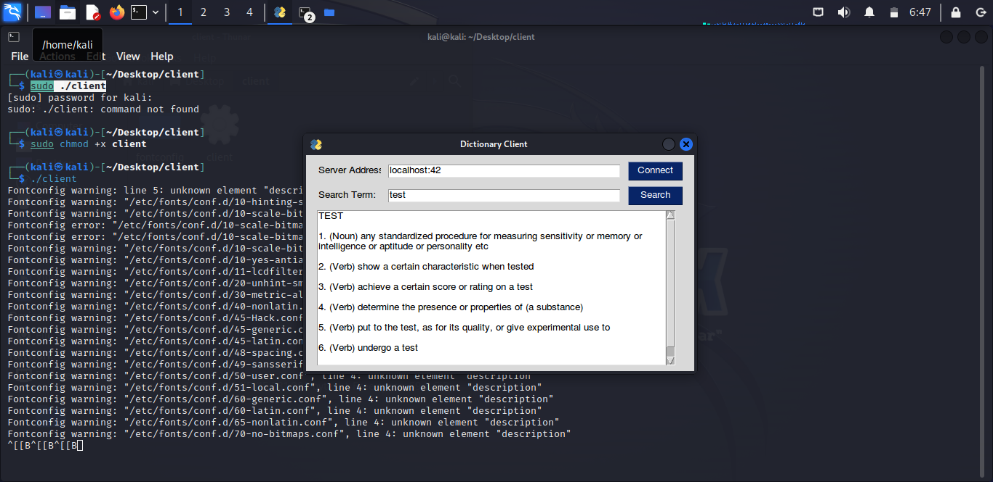
Then I was open the terminal in the client side to Using the dictionary client to connect to the server running inside the container.

Slide 10
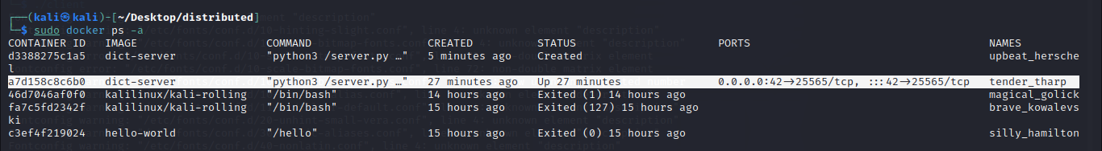
A list of all containers on the system && I highlight the container I am using at this moment:

Slide 11
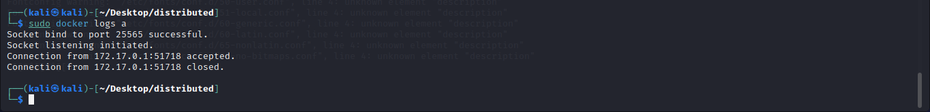
Printing the container’s log to the terminal:

Slide 12
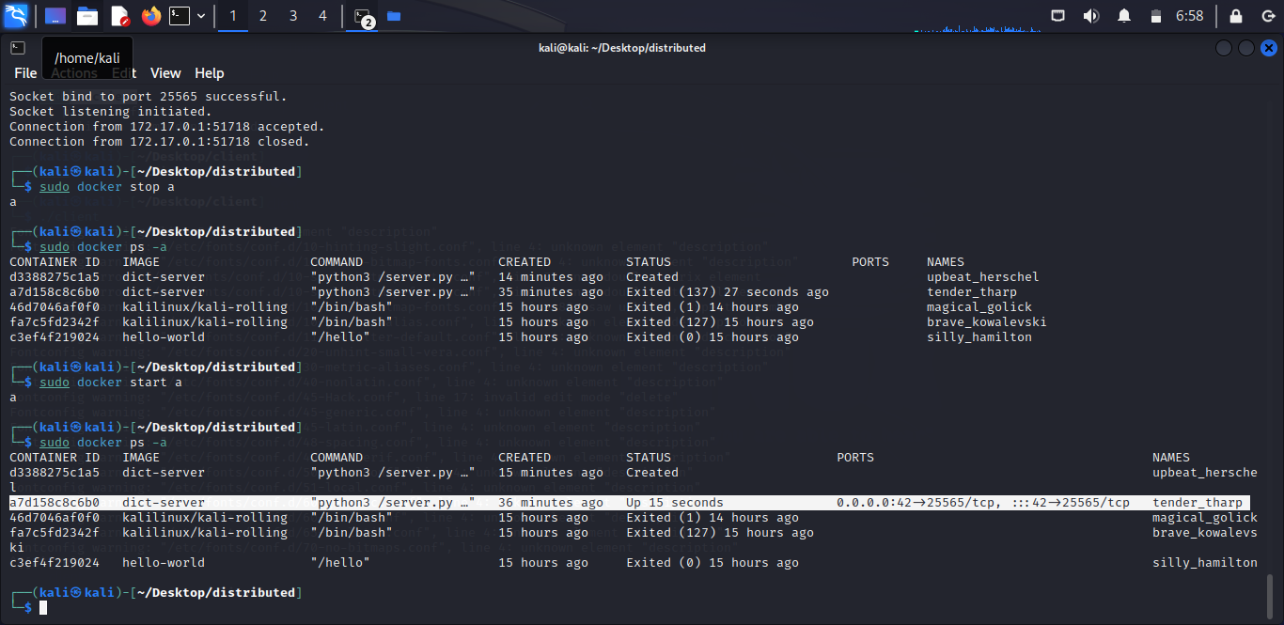
Stopping and starting a Docker container:

Slide 13
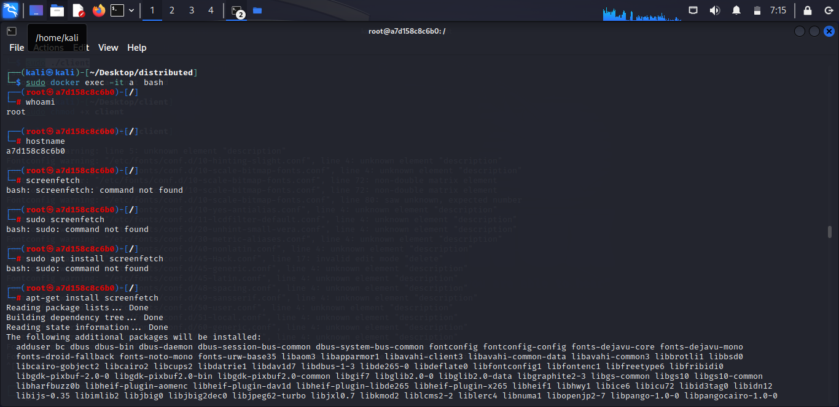
Accessing the bash terminal of a container & Executing commands inside of a Docker container:

Slide 14
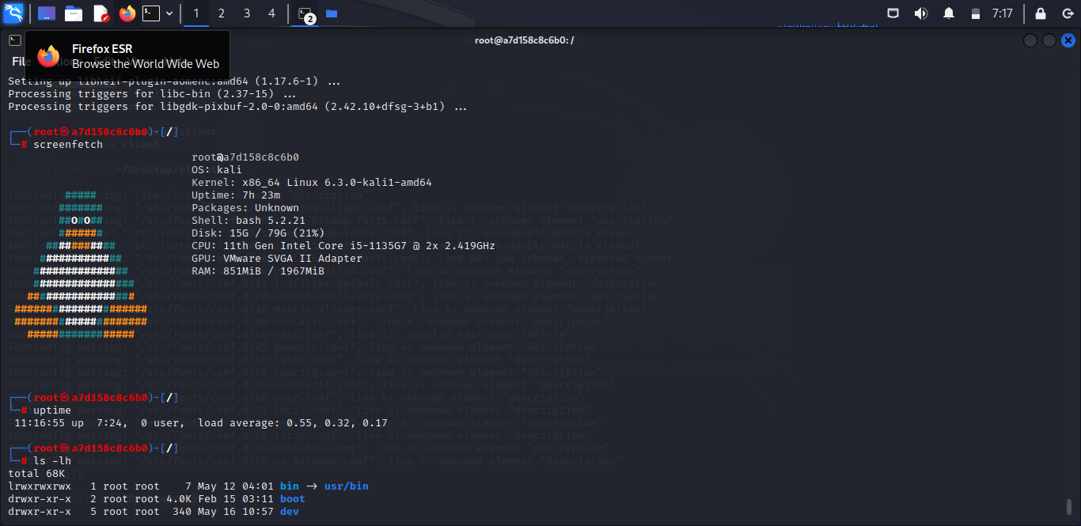
Still Executing commands inside of a Docker container

Slide 15
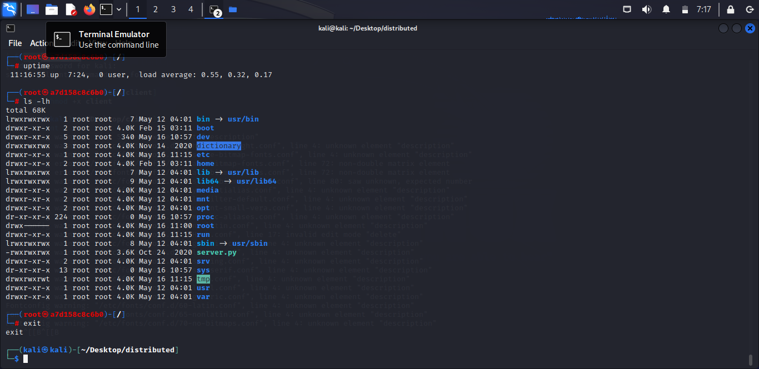
Still ….

Slide 16
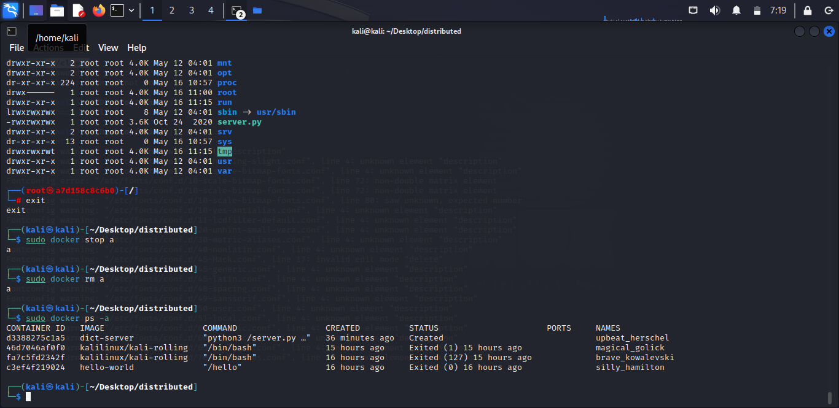
The Docker container has been removed

